Slide 1
Software Quality and Testing

Slide 2
What is Software?
Software is:
Computer programs (Code)
Procedures
Documentation and
Data necessary for operating the software system

Slide 3
Software Quality
SQ- IEEE definition
1) The degree to which a system, component, or process meets specified requirements
2) The degree to which a system, component, or process meets customer or user needs or expectations

Slide 4
SQ Pressman’s Definition
SQ is defined as
◆ Conformance to explicitly stated functional and performance requirements, explicitly documented development standards, and implicit characteristics that are expected of all professionally developed software

Slide 5
Software Quality Assurance
IEEE definition
◆ Quality assurance is A
1.planned and systematic pattern of all actions necessary to provide adequate confidence that an item or product conforms to established technical requirements
2. A set of activities designed to evaluate the process by which the products are developed or manufactured

Slide 6
Software Quality Assurance
SQA – expanded definition
A systematic, planned set of actions necessary to provide adequate confidence that the software development process or the maintenance process of the software system product conforms to established functional technical requirements as well as with the managerial requirements of keeping the schedule and operating within budgetary confines

Slide 7
Quality Control versus SQA
Quality Assurance is process oriented and focuses on defect prevention, while quality control is product oriented and focuses on defect identification.

Slide 8
Quality Control versus SQA
Quality Assurance (QA) is meant to minimize the costs of quality by introducing a variety of activities throughout the development process and maintenance process in order to prevent the causes of errors, detect them, and correct them in the early stages of the development.

Slide 9
Why do we care about Quality?
Development cost | Correction cost& source
Specification: 6% | Req. & Specification: 56%
Design: 5% | Design: 24%
Coding: 7% | Coding: 10%
V&V (Testing): 15% | Other: 10%
Maintenance: 67%

Slide 10
Distinction between Software Errors and Faults
Software Error: section of the code that are incorrect as a result of grammatical, logical or other mistakes made by a system analyst, a programmer, or another member of the software development team
Software Faults are software errors that cause the incorrect functioning of the software during a specific application

Slide 11
Causes of Software Errors
Client- developer communication failures
Deviations from software requirements
Logical design errors
Coding errors
Non compliance with documentation and coding instructions
Shortcoming of the testing process
Documentation errors

Slide 12
Cost of Quality
Cost of quality includes all costs incurred in the pursuit of quality or perform quality related work
Quality cost includes: -
Prevention cost: -
- quality planning
- formal technical reviews
- testing equipment
- training -

Slide 13
Cost of Quality
Appraisal cost:
- in-process and inter-process inspection
- testing
Failure cost:
- rework, repair, and failure mode analysis
- complaint resolution
- product return and replacement

Slide 14
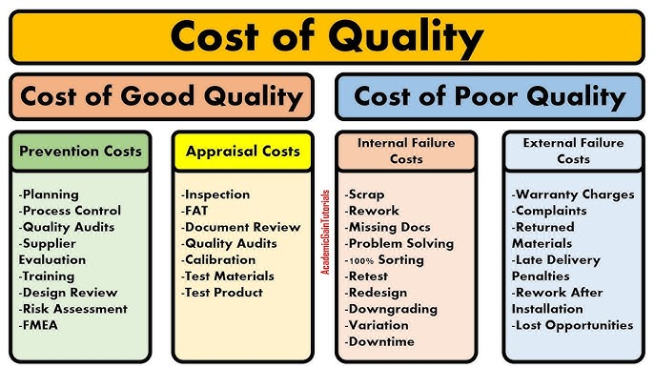
Cost of Quality

Slide 15
Three Views of Quality
Product view:
– functionality, correctness, performance, usability
Process view: –
-efficiency, cost & schedule, failures (rework).

Slide 16
Three Views of Quality
Business view:
– timeliness, customer satisfaction
– does it sell?
– producing the right product at the right time for the right price?

Slide 17
Software Quality Factors
Correctness – accuracy, completeness of required output – up-to-date, availability of the information
Reliability – Minimum failure rate
Efficiency – resources needed to perform software function

Slide 18
Software Quality Factors
Integrity – software system security, access rights
Usability – ability to learn, perform required task
Maintainability – effort to identify and fix software failures (modularity, documentation, etc)
Flexibility – degree of adaptability (to new customers, tasks, etc)

Slide 19
Software Quality Factors
Testability – support for testing (e.g. log files, automatic diagnostics, etc)
Portability – adaptation to other environments (hardware, software)
Reusability – use of software components for other projects
Interoperability – ability to interface with other components/systems

Slide 20
Quality Assurance at each phase of SDLC
Requirements Analysis Phase:
Three major activities that foster quality: – Measurement of process attributes – Verification and Validation – Management
Managing quality in the analysis stage is a challenge.

Slide 21
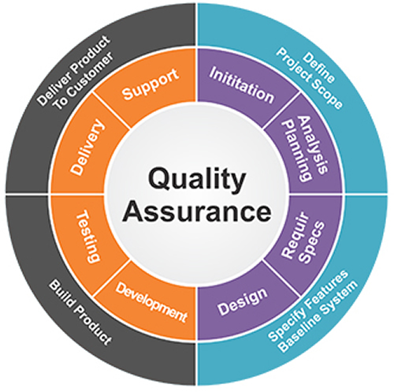
Quality Assurance at each phase of SDLC

Slide 22
Quality Assurance at each phase of SDLC
Requirement Analysis:
QA teams participate from the beginning, ensuring requirements are clear, concise, and testable.
Design Review:
QA reviews design documents to ensure they meet requirements and standards.

Slide 23
Quality Assurance at each phase of SDLC
Coding:
QA professionals review code for adherence to standards and best practices, often through code reviews and unit testing.
Testing:
QA teams create and execute test cases, track bugs, and verify fixes through various testing phases (functional, integration, system, performance).

Slide 24
Quality Assurance at each phase of SDLC
Deployment:
QA ensures the software is ready for release by verifying stability and documentation.
Maintenance:
QA monitors performance, addresses reported issues, and performs regression testing to prevent new problems from arising.

Slide 25
Quality vs reliability vs security vs maintainability
Quality:
Definition: Quality in software engineering refers to the degree to which a system, component, or process meets specified requirements and user needs. It's a holistic measure that includes functionality, usability, performance, and other attributes.
Example: A website that is easy to navigate, loads quickly, and provides accurate information is considered high quality. Conversely, a website with broken links, slow loading times, and inaccurate data is considered low quality.

Slide 26
Quality vs reliability vs security vs maintainability
Reliability:
Definition: Reliability is the probability that a system will perform its intended function for a specified period under given conditions. It focuses on the consistency and correctness of the software's operation over time.
Example: A banking application that consistently processes transactions accurately and without errors is considered reliable. A system that crashes frequently or produces incorrect financial data is unreliable.

Slide 27
Quality vs reliability vs security vs maintainability
Security:
Definition: Security is the ability of a system to protect information and resources from unauthorized access, use, disclosure, disruption, modification, or destruction. It's about preventing breaches and maintaining the integrity of the system.
Example: A secure online store encrypts customer data during transmission and storage, preventing hackers from stealing credit card information. A system with weak encryption or inadequate access controls is vulnerable to security breaches.

Slide 28
Quality vs reliability vs security vs maintainability
Maintainability:
Definition: Maintainability is the ease with which a software system can be modified, enhanced, or repaired. It's about making it easier for developers to understand, change, and fix the code.
Example: A well-documented and modularly designed system is easier to maintain than one with poorly written, heavily tangled code. A maintainable system allows for faster bug fixes, feature additions, and performance improvements.

Slide 29
Software Quality Models
McCall’s Quality Model
Boehm’s Quality Model
CMMI Quality Model

Slide 30
McCall’s Quality Model
Three major perspectives for defining and identifying the quality of a software product:
Product Revision (ability to undergo changes),
Product Transition (adaptability to new environments), and
Product Operations (its operation characteristics).

Slide 31
McCall’s Quality Model
McCall’s Quality Model
The model details the three types of quality characteristics in a hierarchy of
11 Factors,
23 Quality Criteria, and
Metrics

Slide 32
McCall’s Quality Model
Correctness Reliability Efficiency Integrity Usability
Product operation factors
Quality Software
Product revision factors
Maintainability Flexibility Testability
Product transition factors
Portability Reusability Interoperability

Slide 33
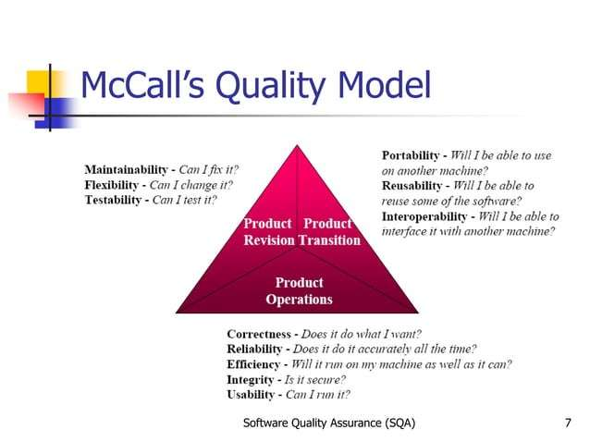
McCall’s Quality Model

Slide 34
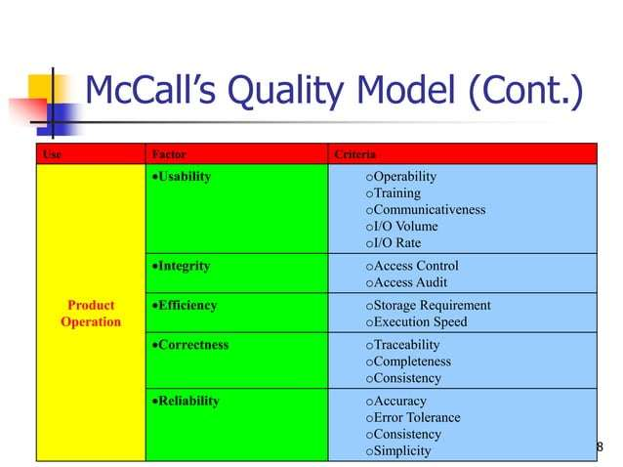

Slide 35
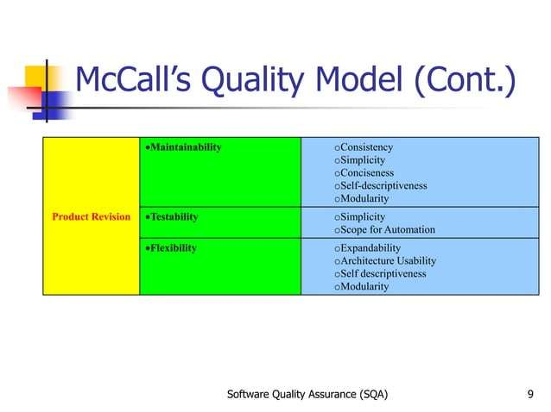

Slide 36
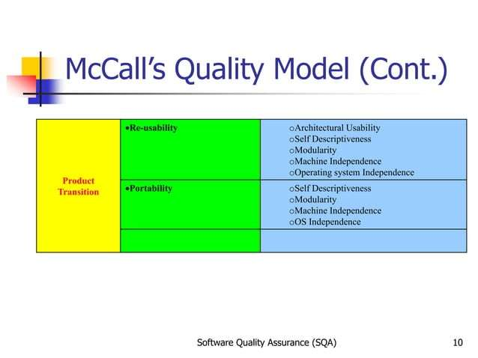

Slide 37
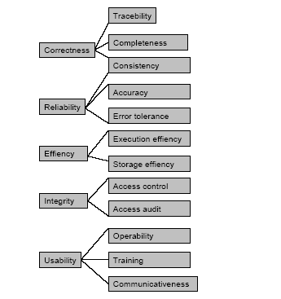
McCall’s Quality Model

Slide 38
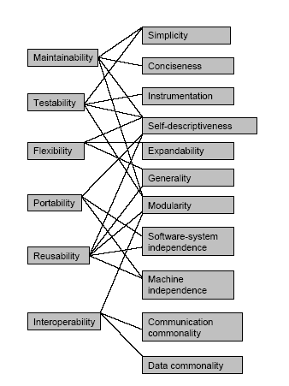
McCall’s Quality Model

Slide 39
Boehm’s Quality Model
Similar to the McCall Quality Model
Presents a hierarchical quality model structured around:
High-level characteristics,
Intermediate level characteristics,
Primitive characteristics

Slide 40
Boehm’s Quality Model
The Highest Level
As is utility ▪️ Extent to which we can use software as-is.
Maintainability ▪️ Effort required to detect and fix an error during maintenance.
Portability ▪️ Effort required to change software to fit in a new environment.

Slide 41
Boehm’s Quality Model
Intermediate Level Characteristic
Portability – Effort required to change software to fit in a new environment.
Reliability – Extent to which software performs according to requirements.
Efficiency – Amount of hardware resources and code required to execute a function.
Usability (Human Engineering) – Extent of effort required to learn, operate and understand functions of the software.

Slide 42
Boehm’s Quality Model
Intermediate Level Characteristic (cont.)
Testability – Effort required to verify that software performs its intended functions.
Understandability – Effort required for a user to recognize logical concept and its applicability.
Modifiability – Effort required to modify a software during maintenance phase.

Slide 43
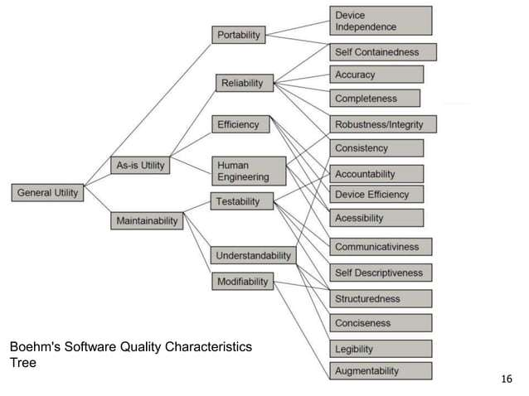
Boehm’s Quality Model

Slide 44
Boehm’s Quality Model
Advantages:
It focuses and tries to satisfy the needs of the user.
It focuses on software maintenance cost effectiveness.
Disadvantages:
It doesn’t suggest how to measure the quality characteristics.
It is difficult to evaluate the quality of software using the top-down approach.

Slide 45
CMMI: Capability Maturity Model Integration
CMMI (Capability Maturity Model Integration) is a proven industry framework to improve product quality and development efficiency for both hardware and software
Sponsored by US Department of Defence in cooperation with Carnegie Mellon University and the Software Engineering Institute (SEI)
Many companies have been involved in CMMI definition such as Motorola and Ericsson
CMMI has been established as a model to improve business results

Slide 46
CMMI: Capability Maturity Model Integration
CMMI, staged, uses 5 levels to describe the maturity of the organization, same as predecessor CMM
Vastly improved version of the CMM
Emphasis on business needs, integration and institutionalization

Slide 47
CMMI: Capability Maturity Model Integration
Models:
Systems Engineering + Software Engineering (SE/SW)
Systems Engineering + Software Engineering + Integrated Product and Process Development (IPPD)
Systems Engineering + Software Engineering + Integrated Product and Process Development + Supplier Sourcing (SS)
Software Engineering only

Slide 48
CMMI: Capability Maturity Model Integration
Representation options:
Staged
Continuous
The CMMI definition of “Systems Engineering” -
“The interdisciplinary approach governing the total technical and managerial effort required to transform a set of customer needs, expectations and constraints into a product solution and to support that solution throughout the product’s life.” This includes both hardware and software.

Slide 49
CMMI Staged Representation - 5 Maturity Levels
Level 5
Process performance continually improved through incremental and innovative technological improvements.
Optimizing
Level 4
Quantitatively
Managed
Processes are controlled using statistical and other quantitative techniques.
Process Maturity
Level 3
Defined
Processes are well characterized and understood. Processes, standards, procedures, tools, etc. are defined at the organizational (Organization X ) level. Proactive.
Level 2
Managed
Processes are planned, documented, performed, monitored, and controlled at the project level. Often reactive.
Level 1
Initial
Processes are unpredictable, poorly controlled, reactive.

Slide 50
CMMI Staged Representation - 5 Maturity Levels
Maturity Level 1 deals with performed processes.
Processes are unpredictable, poorly controlled, reactive.
The process performance may not be stable and may not meet specific objectives such as quality, cost, and schedule, but useful work can be done.

Slide 51
CMMI Staged Representation - 5 Maturity Levels
Maturity Level 2 deals with managed processes.
A managed process is a performed process that is also:
Planned and executed in accordance with policy
Employs skilled people
Adequate resources are available
Controlled outputs are produced
Stakeholders are involved
The process is reviewed and evaluated for adherence to requirements

Slide 52
CMMI Staged Representation - 5 Maturity Levels
Processes are planned, documented, performed, monitored, and controlled at the project level. Often reactive.
The managed process comes closer to achieving the specific objectives such as quality, cost, and schedule.

Slide 53
CMMI Staged Representation - 5 Maturity Levels
Maturity Level 3 deals with defined processes.
A defined process is a managed process that:
Well defined, understood, deployed and executed across the entire organization. Proactive.
Processes, standards, procedures, tools, etc. are defined at the organizational (Organization X ) level.

Slide 54
CMMI Staged Representation - 5 Maturity Levels
Project or local tailoring is allowed, however it must be based on the organization’s set of standard processes and defined per the organization’s tailoring guidelines.
Major portions of the organization cannot “opt out.”

Slide 55
Behaviors at the Five Levels
Maturity Level
Process Characteristics
Behaviors
Focus is on continuous
quantitative improvement
Focus on "fire prevention";
Optimizing
improvement anticipated and
desired, and impacts assessed.
Quantitatively
Managed
Process is measured
and controlled
Greater sense of teamwork and inter-
dependencies
Process is characterized
for the organization and
is proactive
Reliance on defined process. People understand, support and follow the process.
Defined
Process is characterized
for projects and is often
reactive
Over reliance on experience of good
Managed
people – when they go, the process
goes. “Heroics.”
Process is unpredictable,
poorly controlled, and
reactive
Focus on "fire fighting";
Initial
effectiveness low – frustration high.

Slide 56
SQA Team Roles and Skills
Roles:
SQA Manager – Oversees QA strategy and planning.
QA Analyst – Conducts reviews, audits.
Test Engineer – Designs and executes test cases.

Slide 57
SQA Team Roles and Skills
Skills:
SDLC/STLC knowledge
Tools (JIRA, Selenium, Git)
Documentation & communication
Basic scripting/automation

Slide 58
SQA Team Roles and Skills
Org Chart or Hierarchy Tree
SQA Manager
↓
QA Analysts
↓
Test Engineers

Slide 59
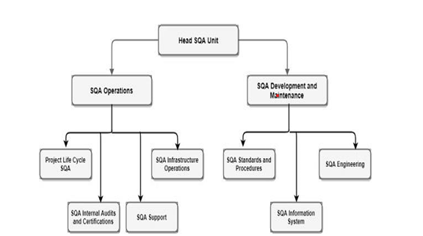
SQA Team Roles and Skills

Slide 60
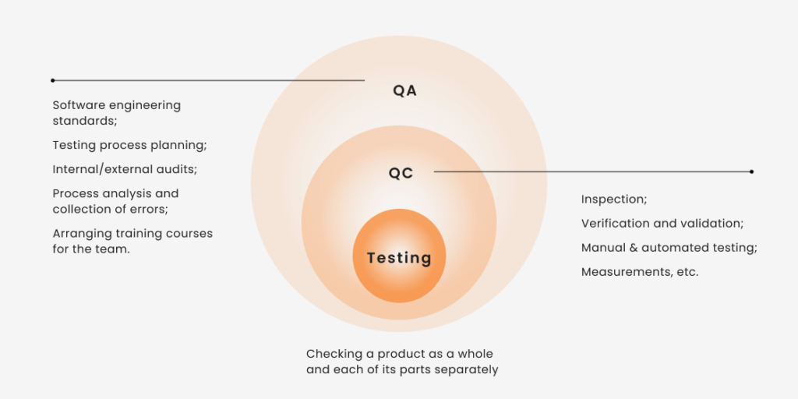
SQA vs QC vs Testing

Slide 61
SQA vs QC vs Testing
Every stage of software development requires a focus on quality.
QA, QC, and testing are the three pillars that ensure the process runs smoothly and the end product meets expectations.
Finding issues early in the software development cycle is crucial.
When quality is maintained from the start through continuous testing, teams avoid costly fixes later.

Slide 62
SQA vs QC vs Testing
Together, they create a cycle of prevention, detection, and improvement that minimizes risks and helps deliver reliable, efficient software.
QA, QC, and testing each play distinct but complementary roles throughout the Software Development Lifecycle (SDLC).

Slide 63
SQA vs QC vs Testing
 | QA | QC | Testing
Approach | Proactive | Reactive | Reactive
Focus | Process-oriented | Product-oriented | Focused on finding mistakes and bugs
Techniques | Manages quality | Verifies quality of the software | All types of testing through manual or automated tools
Timeframe | Throughout the development process | Before the product release | Along the development process
Goal | Define the quality standards and requirements | Ensure that the product’s quality meets the established criteria | Run tests to detect defects in the software and find ways to improve the quality and outcomes
Executor | The entire team, including stakeholders | A small, dedicated quality team | Test engineers, developers

